Slide 1
Chapter 1
Welcome Aboard

Slide 2
Introduction to the World of Computing
Computer: electronic genius?
  NO! Electronic idiot!
  Does exactly what we tell it to, nothing more.
Goal of the course:
You will be able to write programs in C
and understand what’s going on underneath.
Approach:
Build understanding from the bottom up.
Atoms/Electrons ➔ Transistors ➔ Gates ➔ Processor ➔ Instructions ➔ C Programming
1-<number>

Slide 3
Two Recurring Themes
Abstraction
  Productivity enhancer – don’t need to worry about details…
    Can drive a car without knowing how
    the internal combustion engine works.
  …until something goes wrong!
    Where’s the dipstick? What’s a spark plug?
  Important to understand the components and
  how they work together.
Hardware vs. Software
  It’s not either/or – both are components of a computer system.
  Even if you specialize in one,
  you should understand capabilities and limitations of both.
1-<number>

Slide 4
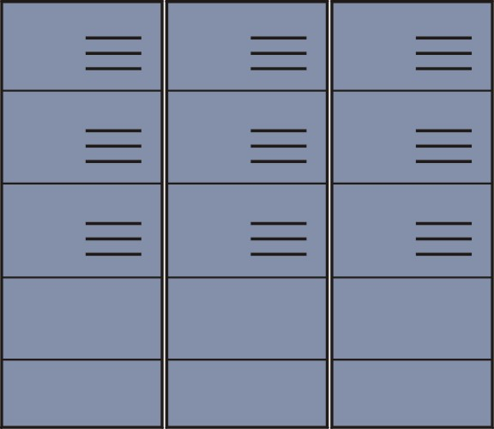
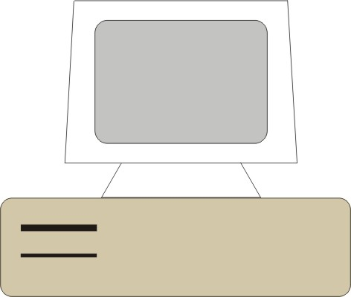

Big Idea #1: Universal Computing Device
All computers, given enough time and memory,
are capable of computing exactly the same things.
=
=
Smart Phone
PC/Workstation
Supercomputer
1-<number>

Slide 5
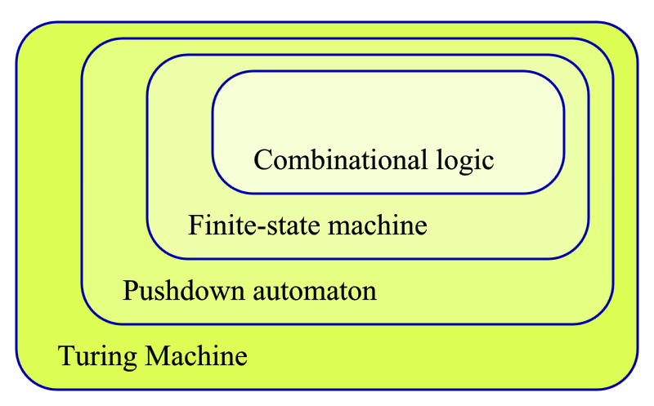
Automata Theory
Source: https://en.wikipedia.org/wiki/Pushdown_automaton
1-<number>

Slide 6
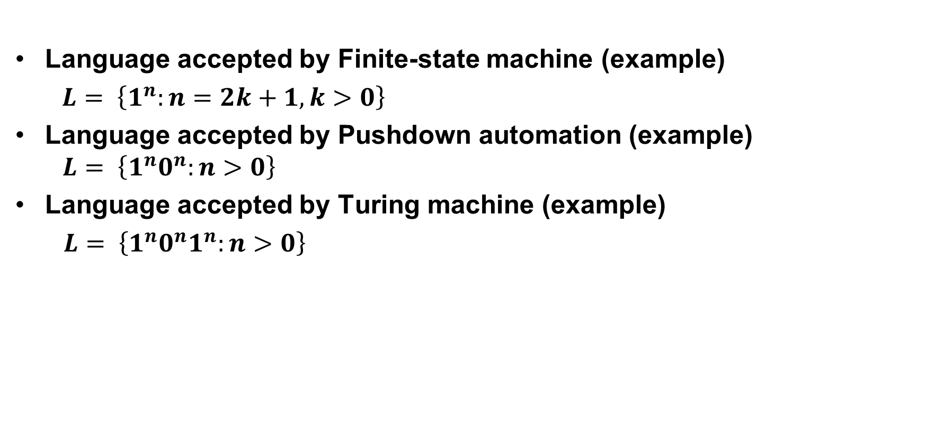
Language Hierarchy
1-<number>

Slide 7
Turing Machine
Mathematical model of a device that can perform
any computation – Alan Turing (1937)
  ability to read/write symbols on an infinite “tape”
  state transitions, based on current state and symbol
Every computation can be performed by some
Turing machine. (Turing’s thesis)
T_{add}
T_{mul}
a,b
a+b
a,b
ab
Turing machine that adds
Turing machine that multiplies
For more info about Turing machines, see
http://www.wikipedia.org/wiki/Turing_machine/
For more about Alan Turing, see
http://www.turing.org.uk/turing/
1-<number>

Slide 8
Universal Turing Machine
A machine that can implement all Turing machines
-- this is also a Turing machine!
  inputs: data, plus a description of computation (other TMs)
T_{add}, T_{mul}
U
a,b,c
c(a+b)
Universal Turing Machine
U is programmable – so is a computer!
  instructions are part of the input data
  a computer can emulate a Universal Turing Machine
A computer is a universal computing device.
1-<number>

Slide 9
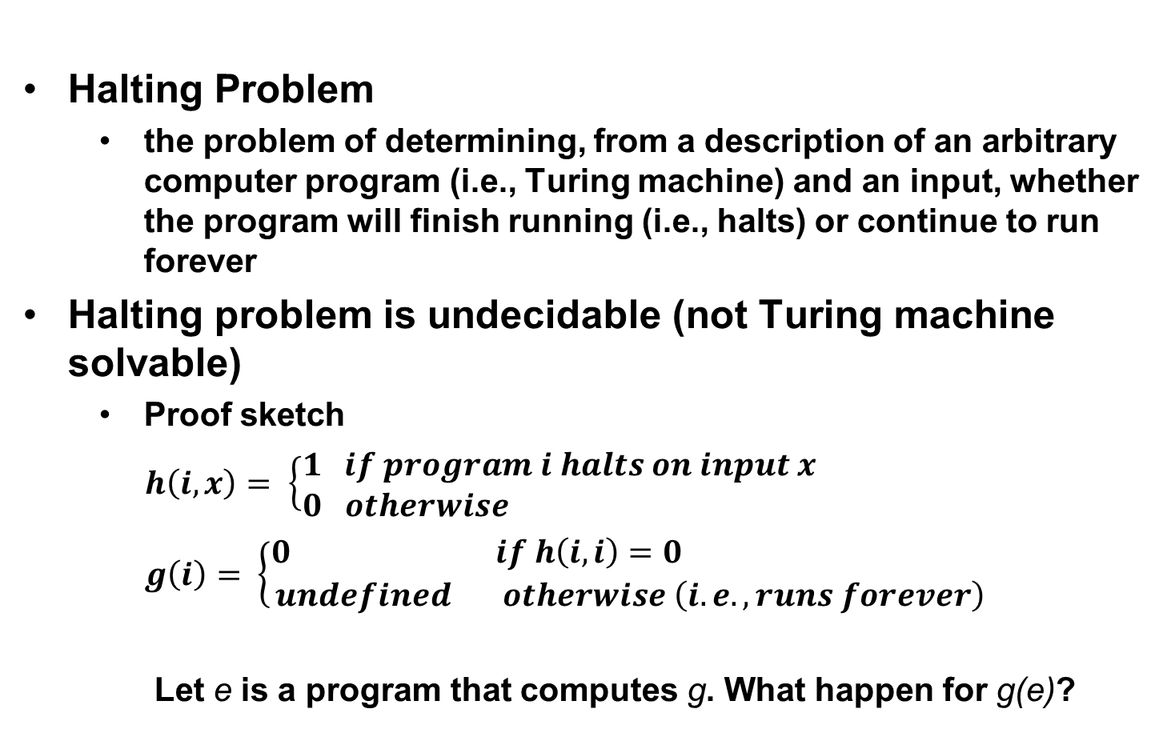
Halting Problem
1-<number>

Slide 10
From Theory to Practice
In theory, computer can compute anything
that’s possible to compute
  given enough memory and time
In practice, solving problems involves
computing under constraints.
  time
    weather forecast, next frame of animation, ...
  cost
    cell phone, automotive engine controller, ...
  power
    cell phone, handheld video game, ...
1-<number>

Slide 11
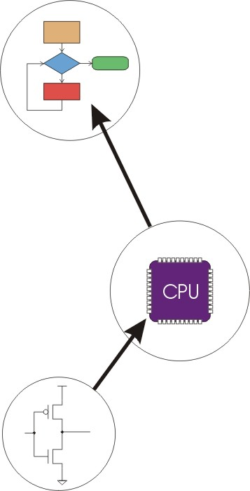
Big Idea #2: Transformations Between Layers
Problems
Algorithms
Language
Instruction Set Architecture
Microarchitecture
Circuits
Devices
1-<number>

Slide 12
How do we solve a problem using a computer?
A systematic sequence of transformations between
layers of abstraction.
Problem
Software Design:
choose algorithms and data structures
Algorithm
Programming:
use language to express design
Program
Compiling/Interpreting:
convert language to
machine instructions
Instr Set
Architecture
1-<number>

Slide 13
Deeper and Deeper…
Instr Set
Architecture
Processor Design:
choose structures to implement ISA
Microarch
Logic/Circuit Design:
gates and low-level circuits to
implement components
Circuits
Process Engineering & Fabrication:
develop and manufacture
lowest-level components
Devices
1-<number>

Slide 14
Descriptions of Each Level
Problem Statement
  stated using "natural language"
  may be ambiguous, imprecise
Algorithm
  step-by-step procedure, guaranteed to finish
  definiteness, effective computability, finiteness
Program
  express the algorithm using a computer language
  high-level language, low-level language
Instruction Set Architecture (ISA)
  specifies the set of instructions the computer can perform
  data types, addressing mode
1-<number>

Slide 15
Descriptions of Each Level (cont.)
Microarchitecture
  detailed organization of a processor implementation
  different implementations of a single ISA
Logic Circuits
  combine basic operations to realize microarchitecture
  many different ways to implement a single function
  (e.g., addition)
Devices
  properties of materials, manufacturability
1-<number>

Slide 16
Many Choices at Each Level
Solve a system of equations
Gaussian
elimination
Jacobi
iteration
Red-black SOR
Multigrid
FORTRAN
C
C++
Java
Tradeoffs:
cost
performance
power
(etc.)
PowerPC
Intel x86
Atmel AVR
Centrino
Pentium 4
Xeon
Ripple-carry adder
Carry-lookahead adder
CMOS
Bipolar
GaAs
1-<number>
Notes:
Sun and Java are trademarks of Sun Microsystems, Inc. Intel, Pentium, Centrino, and Xeon are trademarks of Intel Corporation. AMD and Athlon and trademarks of Advanced Micro Devices, Inc. Atmel and AVR are registered trademarks of Atmel Corporation. PowerPC is a trademark of International Business Machines Corporation.

Slide 17
Course Outline
Bits and Bytes
  How do we represent information using electrical signals?
Digital Logic
  How do we build circuits to process information?
Processor and Instruction Set
  How do we build a processor out of logic elements?
  What operations (instructions) will we implement?
Assembly Language Programming
  How do we use processor instructions to implement algorithms?
  How do we write modular, reusable code? (subroutines)
I/O, Traps, and Interrupts
  How does processor communicate with outside world?
C Programming
  How do we write programs in C?
  How do we implement high-level programming constructs?
1-<number>

